Slide 2
Usability testing (planning, analysis, recommendation)
Duration: 60 mins
Session by :

Slide 3
At the end of this session:
Course takeaways
Know how to identify different approaches to user testing and their appropriate use
Plan and execute real-life usability tests for your projects
Analyze and report the findings

Slide 4
Content:
Course takeaways
Story of Zara
Pillars of Usability Testing
Understand Usability Testing
Resources and Material
Exercise

Slide 5

Usability testing helps to…
Usability Testing
Uncover customers’ needs, challenges and validate the design solutions.
Make faster and more informed decisions based on customer feedback.
Discover opportunities to improve the product.
Let’s check out an example to understand usability testing better!
Notes:
When did we start being concerned with usability? Some will say that such concern is part of being human: cavemen worked their stone tools to get them just right. Interaction design mattered even then. The field of usability research really came into being when the tools we used started to run up against our cognitive and physical limitations. In the first decade of the 20th century, it was the airplanes that were the cause of most usability problems. Planes were costly to make, were made useless after a crash, and caused expensive damage on the ground. Something had to be done to reduce human errors of aviators.
The early years of usability focused on finding the “right kind of people” to fill the jobs of pilots, as opposed to fine-tuning the aeronautics equipment to make it more user-friendly. But when WWII raised the demand for qualified individuals to fly military missions, that strategy of “finding a few good men” wasn’t good enough. The flying machines had to be designed with users in mind, and the true science of human usability was born.
It is fascinating that computers have a similar usability history. The original computing machines were programmed with cables, making actual hard-coded connections to create algorithms. Here also, we needed a few good men to run these machines. But similarly, to men who had the cognitive and physical characteristics to become good pilots, good programmers were hard to find. This was not a workable solution in the long run.
Then after 1970’s Human-Computer Interaction came to light to study and practice usability.

Slide 6

The story of
Story of Zara
Drop-out increase
Zara specializes in fast fashion, and its products include clothing, accessories, shoes, swimwear, beauty and perfumes. Zara is one of the favorite clothing brands, but users have often struggled with its app. This resulted in dropout rate shooting up by 50% and impacting the sales conversion ratio.
50%
Notes:
UX Design Institute – Sample Usability Test Script-3-2-7.pdf

Slide 7
Story of Zara
How did they approach this problem?
Relooked at their checkout process and identified the pain points through interviews and guerrilla testing.
Analyzed why users were dropping out of the purchase funnel.
Created affinity & prioritization mapping to organize pain points into categories.

Slide 8
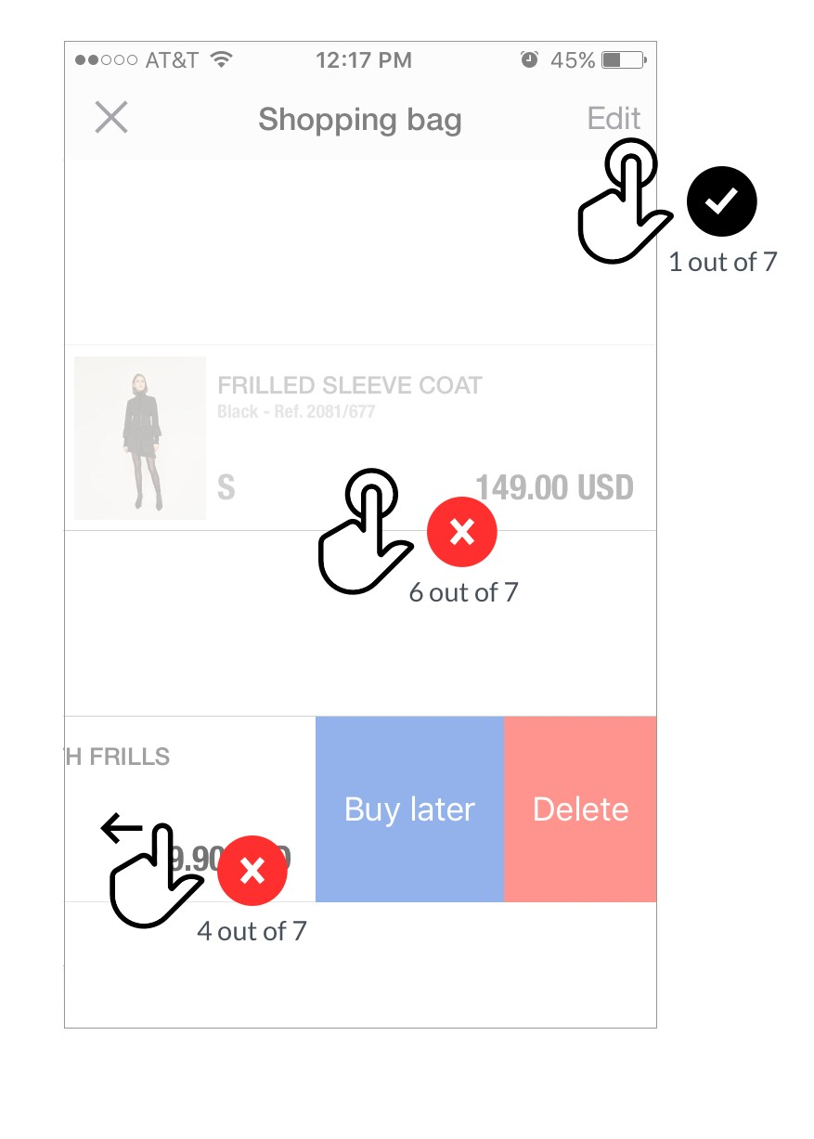
Story of Zara
2 major pain points that came out from the initial testing
Buyers couldn’t edit a specific product within the shopping cart. They had to browse for the same item again to edit the product.
Buyers couldn’t view product details from the shopping cart. They had to go back to the listing page.

Slide 9
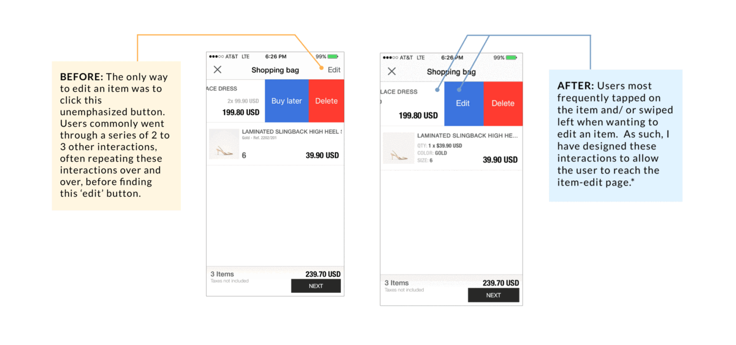
Story of Zara
How did they solve it?
Edit functionality added for each item in the shopping bag
Product details and image galley link added to each item in the shopping bag. consistent with the rest of the app
Reference: https://bit.ly/3PPJCPG
Notes:
UX Design Institute – Sample Usability Test Script-3-2-7.pdf

Slide 10
Story of Zara
As a result of the re-design
Success rate of checkout flow increased by 55% and dropout rates decreased by 35%. The new proposed solution improved the checkout process by facilitating comparison and edits within the cart itself.

Slide 11
So, how do we start a usability test?

Slide 12



Understand the 3 pillars of usability testing
Pillars of Usability Testing
Facilitator
Guides the participant through the test process •The facilitator guides the participant through the test process.
•They provide directions, respond to and pose follow-up questions.
•The facilitator works to ensure that the test results are high-quality and valid data, without accidentally influencing the outcomes of the test by asking leading questions.
Task
Realistic activities that the participant might perform
The tasks in test are realistic activities that the participant might perform in real life.
They can be very specific or very open-ended, depending on the research questions and the type of usability testing.
Users
Potential user of the product or service being studied
The participant should be a potential user of the product or service being studied.
The participant might have a similar background to the target user group, or same needs, even if he isn’t already a user of the product

Slide 13
Set a focused objective

Slide 14
Defining objectives
Understand Usability Testing
"The first step toward gathering useful feedback is setting a clear and focused objective."
Specifying test objectives:
Each usability test session should have a clear purpose and a clear set of research objectives.
Be specific - don’t try to cover everything in the 60 minute session, because you won’t be able to and that won’t yield good data. Remember! Usability testing is different from functional testing or UAT. Functional testing involves testing every possible scenario to make sure the product works and functions.
We are not only testing how well it works, but we are also testing the experience and trying to assess how well the experience helps people achieve their goals and how we can make it work better.
Reference: https://bit.ly/3TgNBrg

Slide 15
Specify the people you want in your study

Slide 16
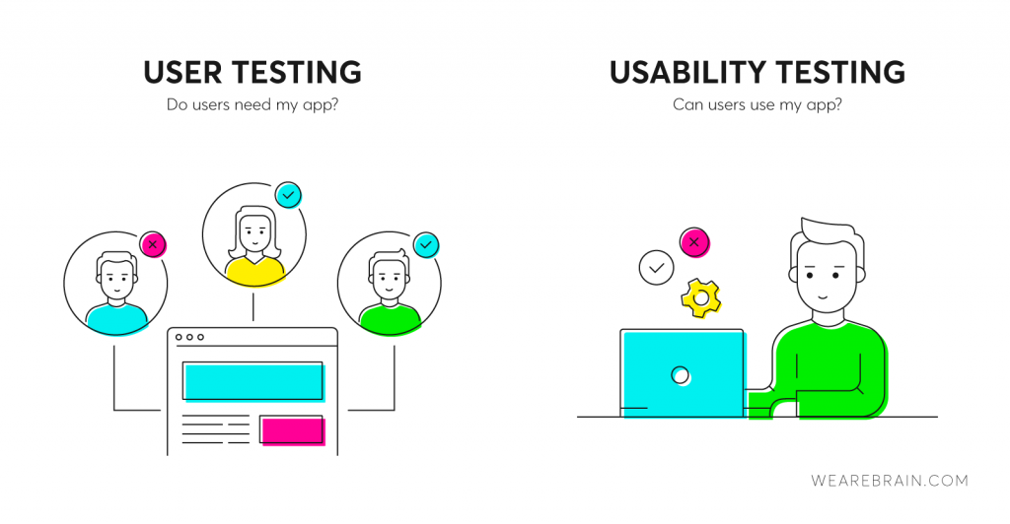

Recruiting users
Understand Usability Testing
For diagnostic usability testing, approx. 10 users or more (based on the complexity of the product, commonly divided into primary users and secondary users) of the given target audience.
There are couple of other ways to find your target users:
Hire an agency
Use social media
Use your website
Download Sample Recruitment Screener
Image Credit: google.com
Notes:
What is a recruitment screener –
A recruitment screener is a document, survey, or call script used to qualify participants for qualitative market research such as focus groups, in-depth interviews, in-home usage tests, and more. Hire an agency: if you're looking for a very specific subsection of the population (like web-savvy oncologists, or single mothers under 35), the most efficient way to find them is to hire a specialized recruitment agency.
Use social media: if you have a social media following, use your social channels to reach out to potential participants.
Use your website: if you already have an established user base, recruit people there.

Slide 17
Determine the best way to get the answers

Slide 18
Understand Usability Testing
Moderated testing
Unmoderated testing
Guerilla testing
Remote
In person
Interviews
Phone interview
Observation
A/B testing
Session recording
Eye tracking
5 Seconds test
Reference: https://bit.ly/3wBT3LU
Notes:
With moderated usability testing, a real person will be there to help facilitate (i.e., moderate) the test. The moderator will work directly with the test contributor, guiding them through the study and answering questions if the contributor encounters any challenges while completing their tasks. What’s great about moderated studies is that they can be conducted either remotely or in-person, you can ask (or answer) questions in real time, and you can open the space for dynamic discussions.
Unmoderated usability testing is just like it sounds. It’s not monitored or guided, so there’s no one else present during the study except the contributor. The contributor completes tasks and answers questions at their own pace, on their own time, at a time and location of their choosing. Pretty nice, right? Unmoderated testing tends to be less time-consuming and more flexible than moderated usability tests, as contributors can complete their tests on their own time without any disruption to daily work.

Slide 19
Understand Usability Testing
 | Qualitative data | Quantitative data
Questions answered | Talk about why? | How many and how much?
Goals | Both formative and summative: Inform design decisions Identify usability issues and find solutions for them | Mostly summative: Track usability over time Compare site with competitors Compute ROI
Outcome | Findings based on the researcher’s impressions, interpretations and prior knowledge | Statistically meaningful data
Methodology | Few participants Think-aloud protocol | Many participants Well-defined, strictly controlled study conditions
Reference: https://bit.ly/2JkQ40p
Notes:
Qualitative data offer a direct assessment of the usability of a system: researchers will observe participants struggle with specific UI elements and infer which aspects of the design are problematic and which work well. They can always ask participants follow-up questions and change the course of the study to get insights into the specific issue that the participant experiences. Then, based on their own UX knowledge and possibly on observing other participants encounter (or not) the same difficulty, researchers will determine whether the respective UI element is indeed poorly designed.
Quantitative data offer an indirect assessment of the usability of a design. They can be based on users’ performance on a given task (e.g., task-completion times, success rates, number of errors) or can reflect participants’ perception of usability (e.g., satisfaction ratings). Quantitative metrics are simply numbers, and as such, they can be hard to interpret in the absence of a reference point. For example, if 60% of the participants in a study were able to complete a task, is that good or bad?

Slide 20
Let’s build your test plan

Slide 21
Understand Usability Testing
Four things to keep in mind while framing a test session:
We are not testing you
Speak your mind
Think out loud
Feel free to ask questions
Notes:
We are not testing you - You must let them know, while this is called a usability test, we are testing the product. So, there are no right or wrong answers, we are not trying to catch them out, there are no trick questions. And if they do come across any problems, then it's not their fault, but fault of the software.
Speak your mind - We want them to be as candid as possible, if they don’t like something or if they think somethings confusing, we want to make sure that they tell us.
Think out loud - The third thing is thought aloud protocol. We tell them to verbalise each thought, what are they trying to do, what are they looking for, what they expect to see after clicking on something. That will help us take good notes.
Feel free to ask questions - finally, in the introduction, let them know they are absolutely free to ask questions whenever they want.

Slide 22
Understand Usability Testing
Prepare a test script:
A usability test script is an example of where a little preparation goes a long way. Because a lot happens during a usability test, and as a facilitator
You are trying to hold a conversation with the user.
You are trying to make sure they are relaxed.
You are trying to observe what they are doing and ask appropriate questions as they do so.
Overall, you are trying to steer the test session in the right direction. So, in this situation, it’s not possible to think of appropriate questions on the fly.
“The more work you put in upfront, the more it pays off downstream.”

Slide 23
Understand Usability Testing
Define Goals:
Usability goals must address the 5 usability components: learnability, effectiveness, efficiency, errors and satisfaction.
Here are some examples of how to frame usability goals:
Understand why people drop out of the purchase funnel.
Are we delivering a uniform experience across the app?
Why are up-selling & cross-selling modules not performing?
A test script is an aide – memoire:
It outlines the tasks you want people to complete on our software, and then within these tasks, the questions we want to ask along the way.
Overall, it gives the test structure and
It allows you to deviate from the standard tasks when people do unexpected things, which they often do.

Slide 24
Understand Usability Testing
Start with a couple of personal & topic/ theme specific questions
Example of personal questions:
Where do you live?
How do you access the internet? (Computer? Laptop? Phone? Please explain the usage pattern)
Do you use apps on your smartphone?
What sort of apps do you use? Please describe
Example of theme/ topic specific questions:
What sort of travelling do you typically do?
Business or leisure? Please elaborate
How frequently do you fly?
Where do you fly to (national/ international)?
How do you book the flights? Can you please elaborate in steps?

Slide 25

Understand Usability Testing
Note:
Indicate what you are testing:
Give the name of the Web site, Web application or other product.
Specify how much of the product the test will cover in the form of tasks and user flows (e.g. the prototype as on a specific date, the navigation, navigation and content).
Pro Tips:
When you’re gearing up for your test, try this tip. Run a very open-ended test using broad tasks like: “Explore this website/app as you naturally would for 10 minutes, speaking your thoughts aloud.”
You’re sure to uncover new areas to study in a more targeted follow-up test.
Download Sample Test Script

Slide 26
Bring the data, measure success and share findings

Slide 27
Analyzing usability test findings:
Understand Usability Testing
Try to keep your usability testing report short, the findings actionable and focus on delivering something your team can act upon.
Organize the usability issues you identified
Prioritize issues based on criticality and impact
Present the findings with your team
Alternatively, you can also use the following tools to create your usability test report:
Maze
Lookback
Xtensio
Hotjar
Google Analytics
Notes:
Organize the usability issues you identified - You probably have multiple data points by now. The first step to understanding them is to organize the issues you recorded during usability testing.
The most straightforward method is to write down every single issue along with a comprehensive description of where in the design it happened, how it occurred, and the task the user was performing, plus all of the details that describe the problem. On one side, include each task with its respective issue. On the other, include a list of all your usability test participants so you can mark down every user who’s experienced the same issue.
Prioritize issues based on criticality and impact:
4 - Critical: Examples: The user didn’t receive a confirmation message after making a payment or they can’t sign up for an account.
3 - Serious: Examples: The user can’t navigate to the next page in their flow or can’t reset their password.
2 - Medium: Examples: The user has to scroll a lot to find a category in a dropdown or the text is too small on the Pricing page
1 - Low: Examples: a misspelled word in the heading or a logo that isn’t updated on the About us page.
0 - No issue
Present the findings with your team:
A successful usability testing presentation can help internal teams understand which aspects of their product or service
resonating with users and what has room for improvement.
https://bit.ly/3wBhYPk

Slide 28
Material & resources

Slide 29
Resources and Material
UX Talks & Tutorials
www.youtube.com/watch?v=nYCJTea1AUQ&t=20s
https://www.youtube.com/watch?v=PVvZdC6RIlU
www.youtube.com/watch?v=2U0PfOQNlZg
https://www.youtube.com/watch?v=0qPMd7SuGfQ
Study Material/ Courses
https://www.udemy.com/course/usability-testing
https://www.coursera.org/learn/evaluating-designs-with-users
https://www.coursera.org/learn/ui-testing
https://www.uxdesigninstitute.com/blog/find-users-usability-test/

Slide 30
Hands-on exercises

Slide 31
Exercise:
Exercise
Task Details: Book a round trip from Delhi to Mumbai. Depart on a Saturday and return on Tuesday, two months from now, for 2 people.
Exercise Objective: Find out the primary pain points users face based upon five elements of usability and prepare a findings report.
Session Time: 1 Hour
Number of users: 5
User’s Goal: Explore airline ticket booking on - www.akasaair.com website and book a ticket.
Note: For this task, you can refer to the usability test script provided earlier in the session to you.
Notes:
There will be two parts to the task, first, we will have one team that will act as facilitators and the others as users., you will have to carry out the task and secondly, share your findings that will improve the user journey. The facilitators will have to go through the website first to decide on their test objectives and prepare a test plan.

